Slide 1
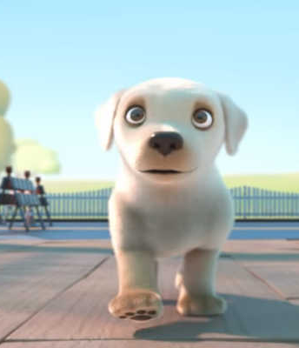
PIP!
Year 2
wednesday

Slide 2
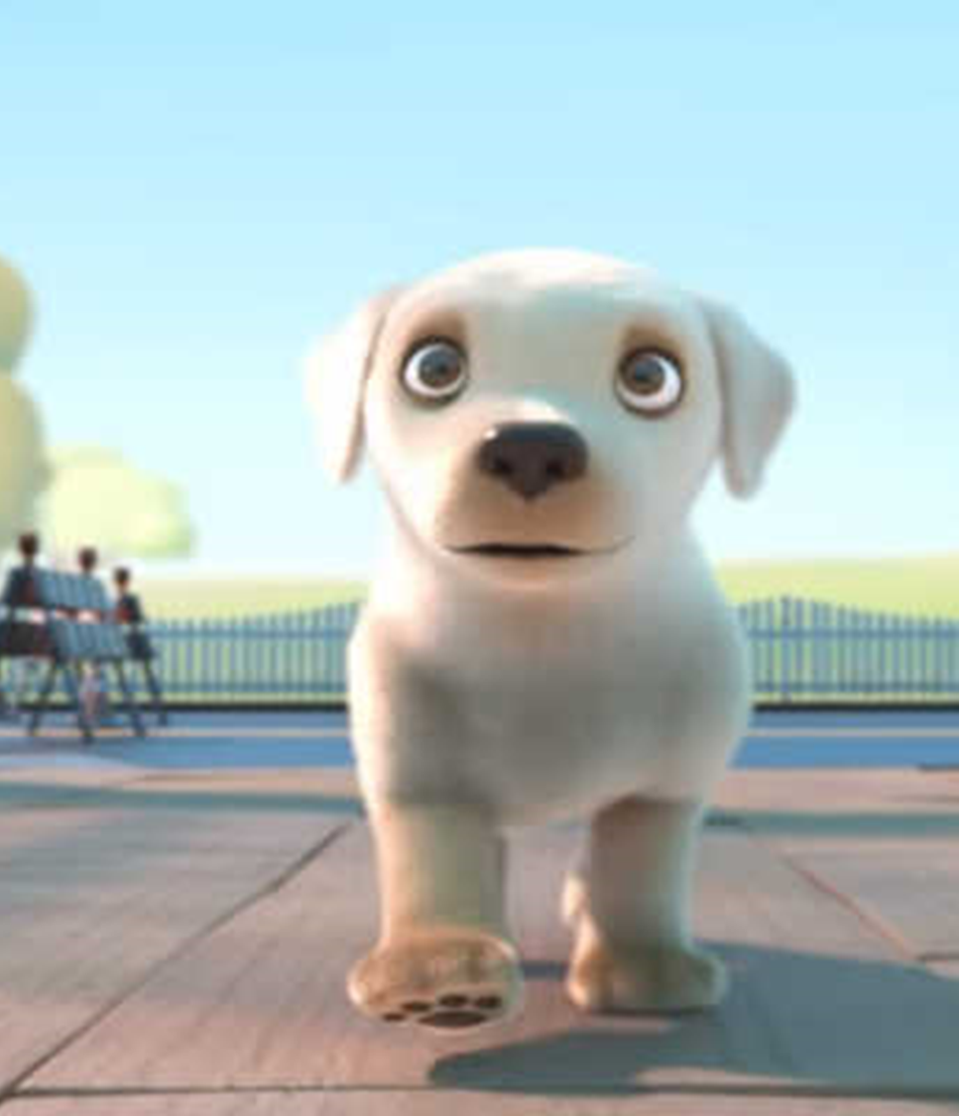
Today you are going to watch a short film called ‘PIP’.
Before you watch it. Talk to an adult about the next three slides and the vocabulary words from the story. Discuss what they mean.
There are not many words in this film, but you will see or hear these three in the film so listen and look carefully!

Slide 3

inspire
Vocabulary
Word Family
inspires
inspired
inspirational
To move someone to act, create, or feel emotions.
I want to inspire others by always believing that I can do it!
Notes:
What else could be abandoned? What feelings does the word give you? Would you want to be abandoned?

Slide 4
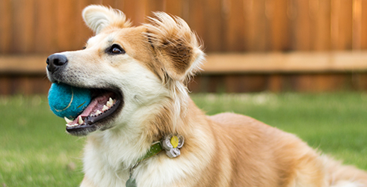
canine
Vocabulary
Word Association
Canine
Pooch
Hound
Dog
A scientific name
for a dog
My Border Collie is a canine and is my best friend.
Notes:
What else could be abandoned? What feelings does the word give you? Would you want to be abandoned?

Slide 5

“Leads the pack”
Vocabulary
Word Association
Shine
Lead
In charge
To be the leader of a group.
I wanted to “lead the pack” on our trek up the mountain.
Notes:
What else could be abandoned? What feelings does the word give you? Would you want to be abandoned?

Slide 6
Pip!
Let’s watch the film!
Click on the link below: https://www.youtube.com/watch?v=07d2dXHYb94
Put your hands on your head when you see the word:
Inspire
Canine
‘Leads the pack’

Slide 7
Learning Intention:
I will listen for a particular purpose.​
​
Success criteria:
I can listen to the story and answer questions about what I saw. ​
​

Slide 8
Discussion question with an adult.
Question 1
What is the setting of the story?
Question 2
How do you think Pip would have been feeling arriving on his first day?

Slide 9
Discussion questions
Question 3
Question 4
Who was the main character?
What problem did he face?

Slide 10
Discussion questions
Question 5
Question 6
What went wrong for Pip at training school?
What was the ‘turning point’ for Pip at training school?

Slide 11
Discussion questions
Question 7
Question 8:
How did Pip change throughout the story?
Was there a ‘climax’ to the complication or problem in the story? If so, what was it?

Slide 12
Discussion questions
Question 9
Question 10
Do you like this film?
Why or why not?
What message is the film creator trying to give us about our own lives?

Slide 13
Discussion questions
Question 11
Why did Pip want to attend Canine University?

Slide 14
PIP!
Year 2
THURSDAY

Slide 15
You are going to watch the short film called ‘PIP’ again today.
Before you watch it. Talk to an adult about the next three slides and the vocabulary words from the story.
See if you can remember what they mean and where they are used in the film.

Slide 16
inspire
Vocabulary
Word Family
inspires
inspired
inspirational
To move someone to act, create, or feel emotions.
I want to inspire others by always believing that I can do it!
Notes:
What else could be abandoned? What feelings does the word give you? Would you want to be abandoned?

Slide 17
canine
Vocabulary
Word Association
Canine
Pooch
Hound
Dog
A scientific name
for a dog
My Border Collie is a canine and is my best friend.
Notes:
What else could be abandoned? What feelings does the word give you? Would you want to be abandoned?

Slide 18
“Leads the pack”
Vocabulary
Word Association
Shine
Lead
In charge
To be the leader of a group.
I wanted to “lead the pack” on our trek up the mountain.
Notes:
What else could be abandoned? What feelings does the word give you? Would you want to be abandoned?

Slide 19
Pip!
Let’s watch the film!
Click on the link below: https://www.youtube.com/watch?v=07d2dXHYb94
Put your hands on your head when you see the word:
Inspire
Canine
‘Leads the pack’

Slide 20
Learning Intention:
I will understand the structure of the story.​
​
Success criteria:
I can identify the parts of the story.​
​

Slide 21
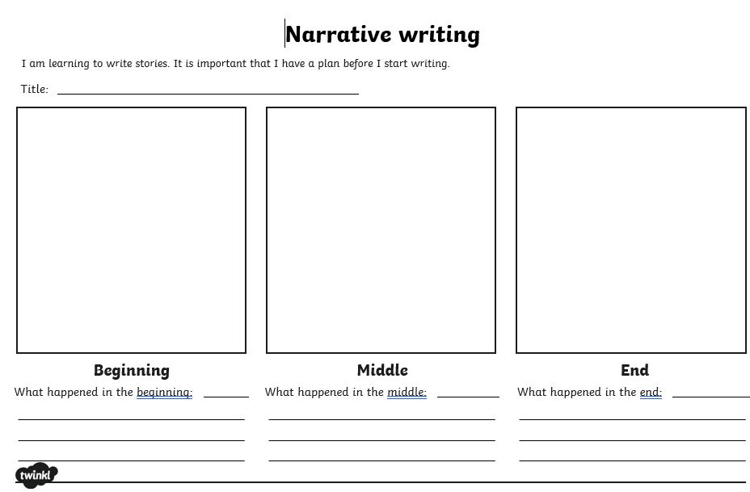
STRUCTURE of the Story
Discuss with an adult what happened in the beginning, middle and end of the story.
What was the problem and how did the problem get solved?
Draw or write about it on the template. Link on website

Slide 22
PIP!
Year 2
FRIDAY

Slide 23
You are going to watch the short film called ‘PIP’ again today.
Before you watch it. Talk to an adult about the next three slides and the vocabulary words from the story.
See if you can remember what they mean and where they are used in the film.

Slide 24
inspire
Vocabulary
Word Family
inspires
inspired
inspirational
To move someone to act, create, or feel emotions.
I want to inspire others by always believing that I can do it!
Notes:
What else could be abandoned? What feelings does the word give you? Would you want to be abandoned?

Slide 25
canine
Vocabulary
Word Association
Canine
Pooch
Hound
Dog
A scientific name
for a dog
My Border Collie is a canine and is my best friend.
Notes:
What else could be abandoned? What feelings does the word give you? Would you want to be abandoned?

Slide 26
“Leads the pack”
Vocabulary
Word Association
Shine
Lead
In charge
To be the leader of a group.
I wanted to “lead the pack” on our trek up the mountain.
Notes:
What else could be abandoned? What feelings does the word give you? Would you want to be abandoned?

Slide 27
Pip!
Let’s watch the film!
Click on the link below: https://www.youtube.com/watch?v=07d2dXHYb94
Put your hands on your head when you see the word:
Inspire
Canine
‘Leads the pack’

Slide 28
Learning Intention: I will use my knowledge of punctuation to create a sentence.
Success Criteria:
I can reorder words in a jumbled-up sentence, correctly.

Slide 29
GRAMMAR Unjumble the sentences so that they make sense.
We do
the University. Pip Canine arrived happily at
trainers impress the Pip wanted University. the to at Canine

Slide 30
GRAMMAR Unjumble the sentences so that they make sense.
Answers
Pip arrived happily at the Canine University.
Pip wanted to impress the trainers at the Canine University.

Slide 31
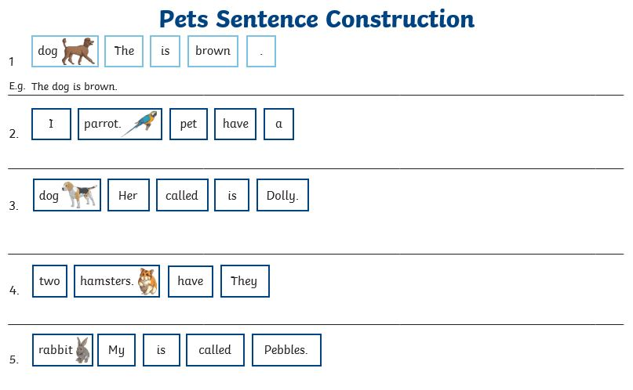
GRAMMAR
YOU do
Unjumble the sentences so they make sense. Rewrite correctly ON THE WORKSHEET. (Link to three different sheets are on the website- you can choose one or do all three!)
​

