Slide 2
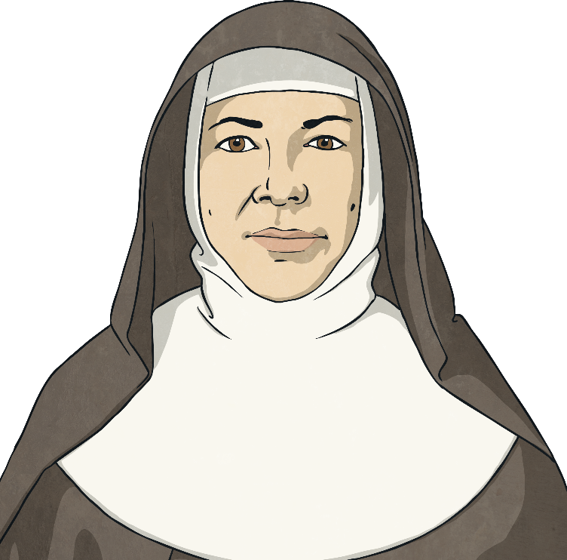
On 15th January 1842, Mary Helen MacKillop was born in Fitzroy, Melbourne, Victoria.
Mary MacKillop’s parents were Flora MacKillop (nee MacDonald)
and Alexander MacKillop.
She spent most of her childhood in Victoria.

Slide 3
Flora MacKillop
(MacDonald)
1816-1886
Alexander MacKillop
1812-1868
Mary
MacKillop
1842-1909
Margaret
MacKillop
1843-1872
John
MacKillop
1845-1867
Alick
MacKillop
1847-1848
Annie
MacKillop
1848-1929
Alexandrina
MacKillop
1850-1882
Donald
MacKillop
1853-1925
Peter
MacKillop
1857-1878
Mary was the eldest of eight children. However, due to financial hardship, it wasn’t until 1860 that the children lived together. Most of the time they spent time living with relatives.

Slide 4
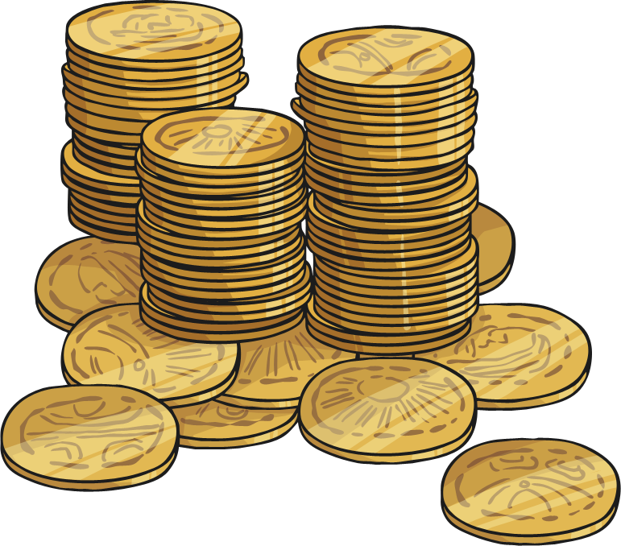
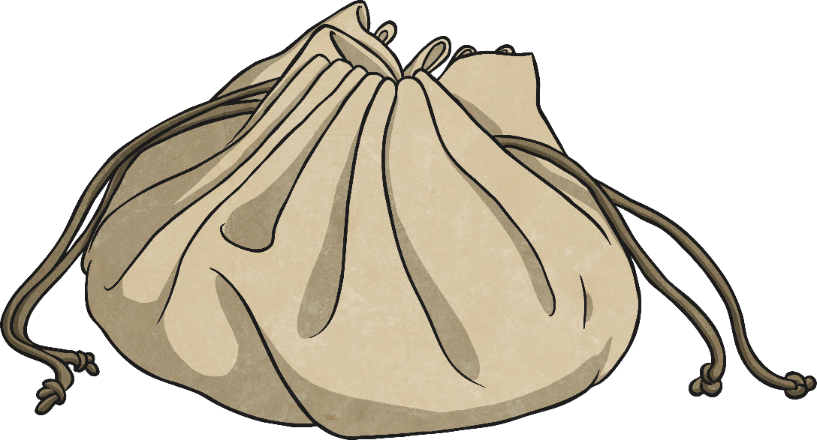
When Mary was sixteen, she had to start financially supporting her family by working as a clerk.
Both Mary and her brother John were in charge of caring and providing for their mother and five younger siblings.

Slide 5
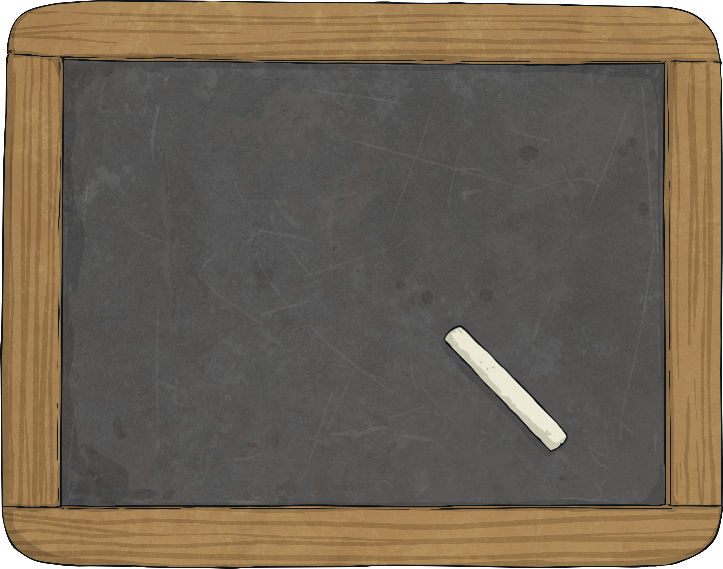
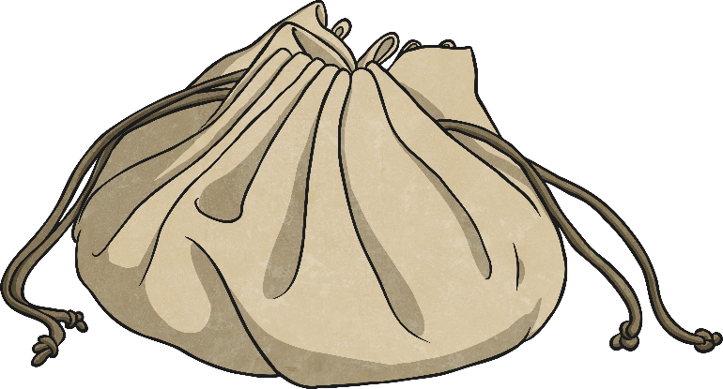
At the age of 18, Mary moved to Penola in South Australia to take on the role of governess to her Aunt Margaret and Uncle Alexander Cameron’s children.
She still needed to send money to her mother to help take care of the four youngest children back in Melbourne.

Slide 6
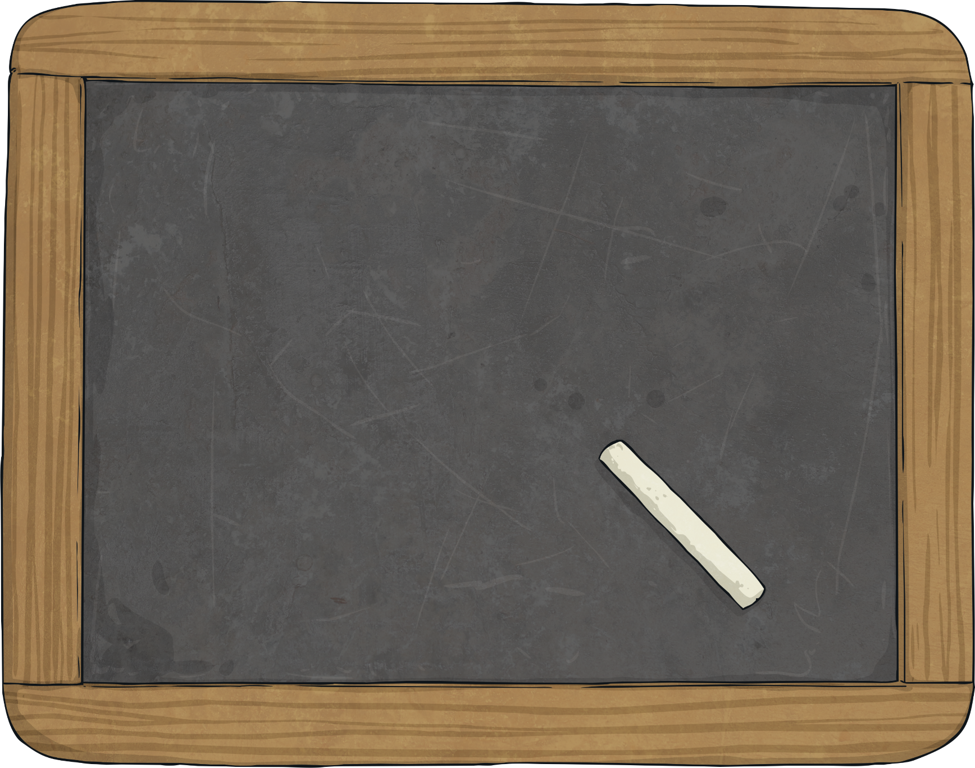
During her time in Penola, Mary educated the children in the Cameron’s household and also started conversing with Father Julian Tenison Woods, who at the time was the priest-in-charge of the Penola Mission.

Slide 7
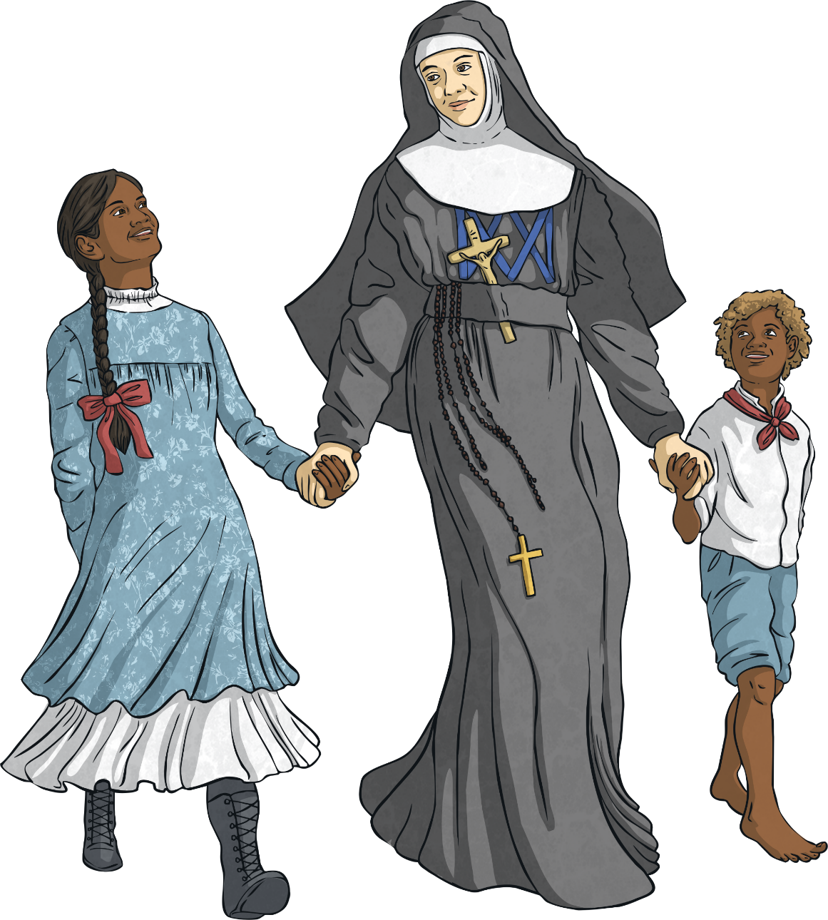
Father Woods needed help starting a local school. So, in 1866, Father Woods and Mary formally opened the first Saint Joseph’s School, which was situated in a disused stable. She wanted to ensure that everyone received a good education. Mary’s two sisters then travelled from Victoria to join her.

Slide 8
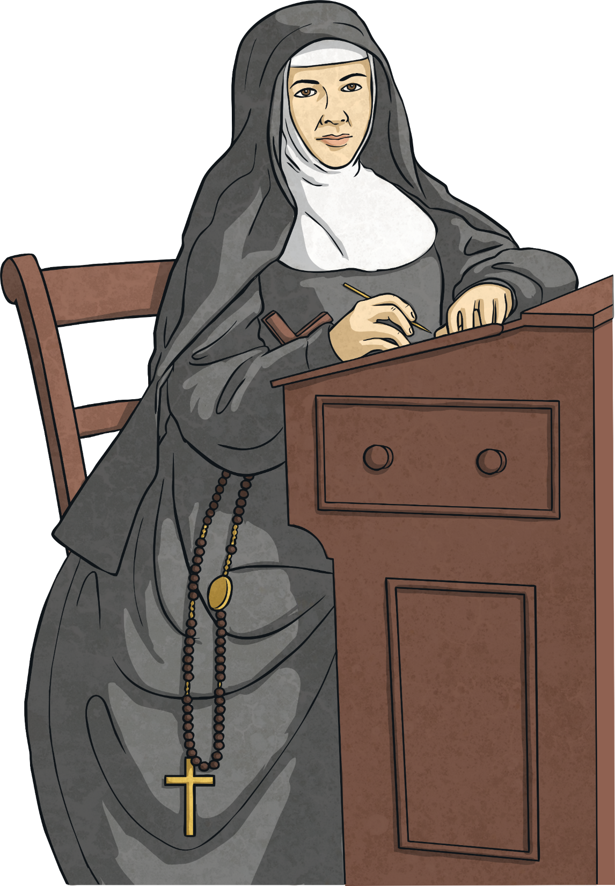
On 19th of March 1866, on the Feast of St Joseph, Mary became known as Mary, Sister of St Joseph. From that day on, the Congregation of Sisters of St Joseph commenced. Then in Adelaide on 15th August 1867, Mary MacKillop officially took her vows and became a nun, Mary of the Cross.

Slide 9

Mary MacKillop was invited to open a school in Adelaide by Bishop Shiel in 1867.
The Sisters started to spread to cities in Australia, New Zealand, Peru, Brazil and refugee camps in Uganda and Thailand.
Mary spent her life giving and caring for others by opening orphanages, homes for the homeless, schools and hospitals.

Slide 10
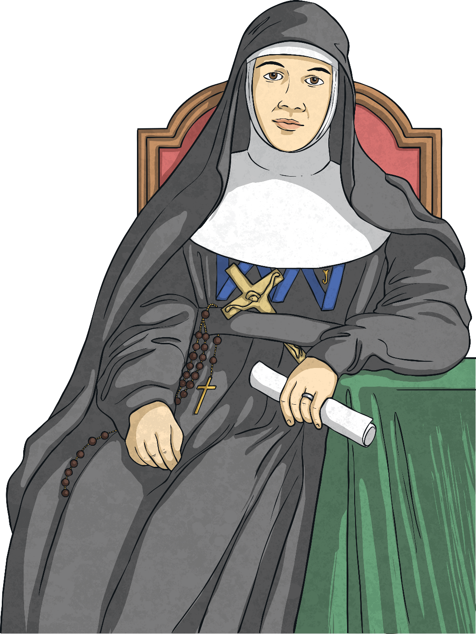
Mary suffered a severe stroke in 1902 and was confined to a wheelchair. Her health continued to deteriorate and Mary MacKillop passed away on 8thAugust 1909.
Pope John Paul II declared that she could become Australia’s first saint on January 9th, 1995.

