Slide 1
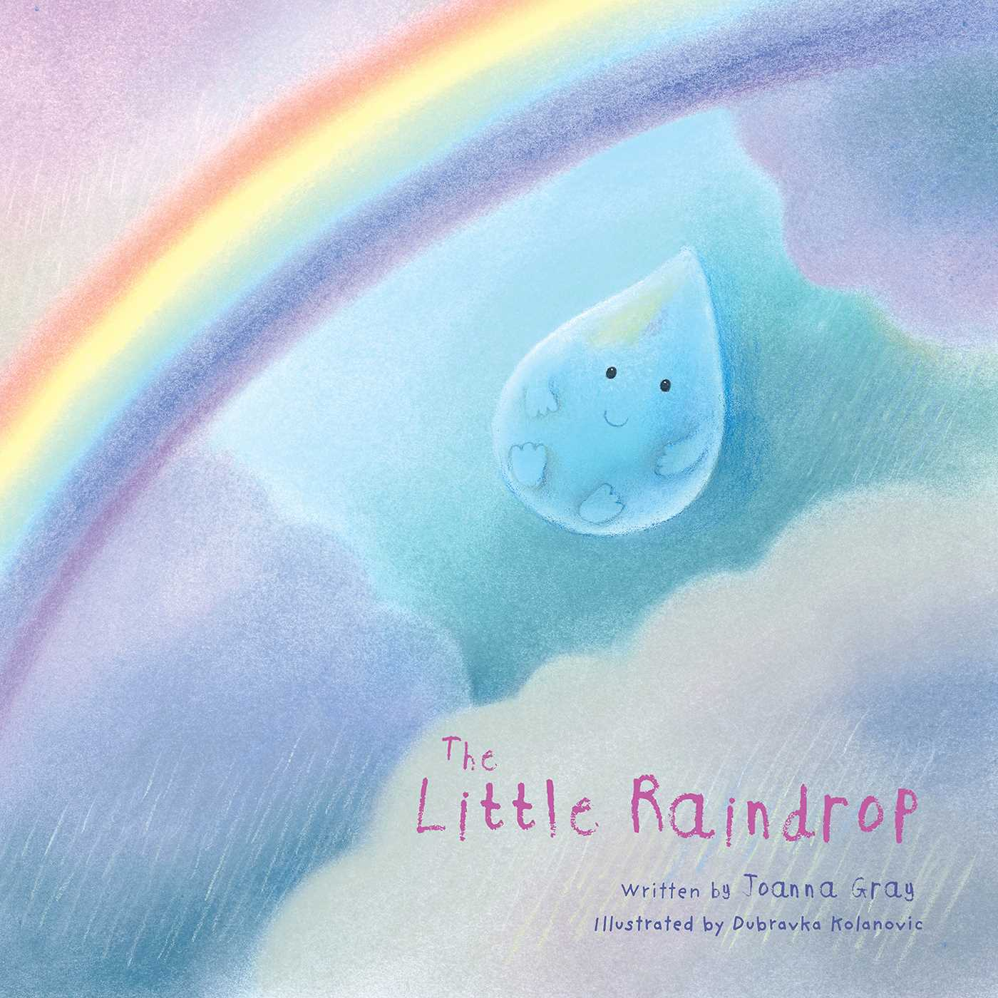
The Little Raindrop
Year 2
Monday

Slide 2
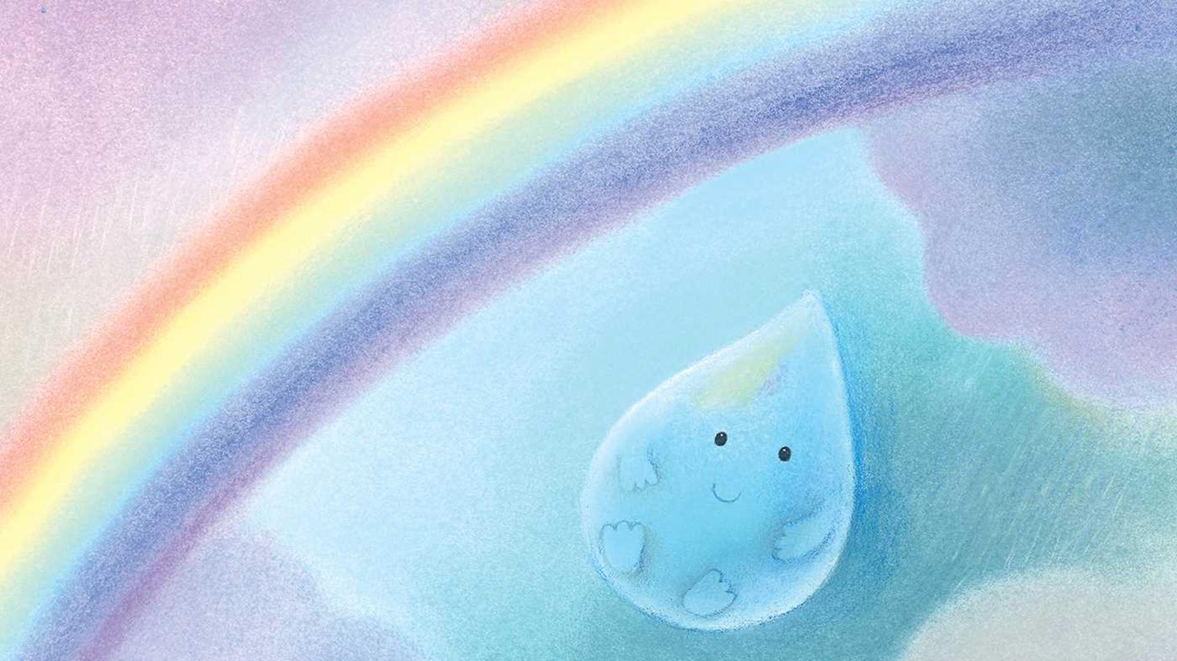
Today you are going to read a story called ‘The Little Raindrop’.
Before you watch the read aloud story, talk to an adult about the next few slides and the vocabulary words from the story.
Discuss what they mean.

Slide 3
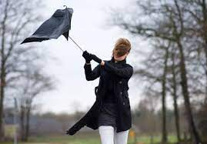
gust
Vocabulary
Word Family
gusty
A sudden strong rush of wind.
The umbrella blew inside out in the sudden gust of wind.

Slide 4
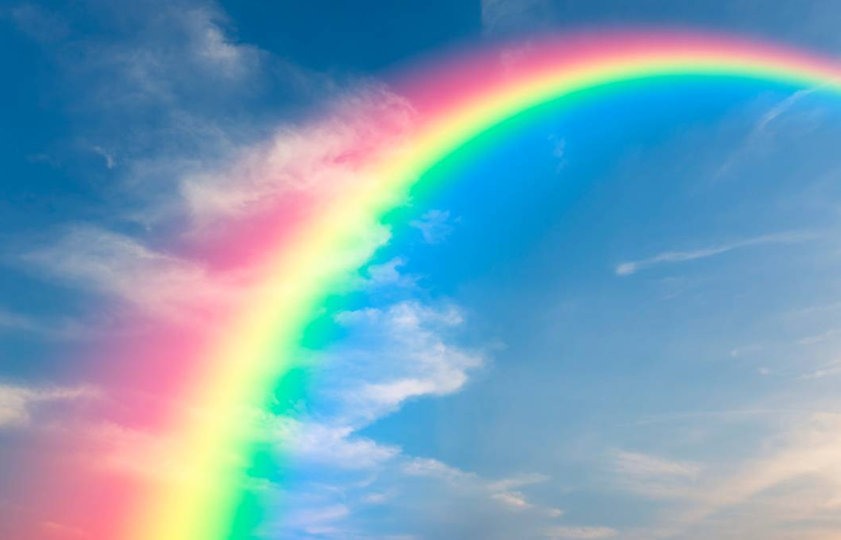
dazzling
Vocabulary
Word Family
dazzled
dazzle
Very bright and beautiful.
I saw the most dazzling rainbow on my walk today.

Slide 5
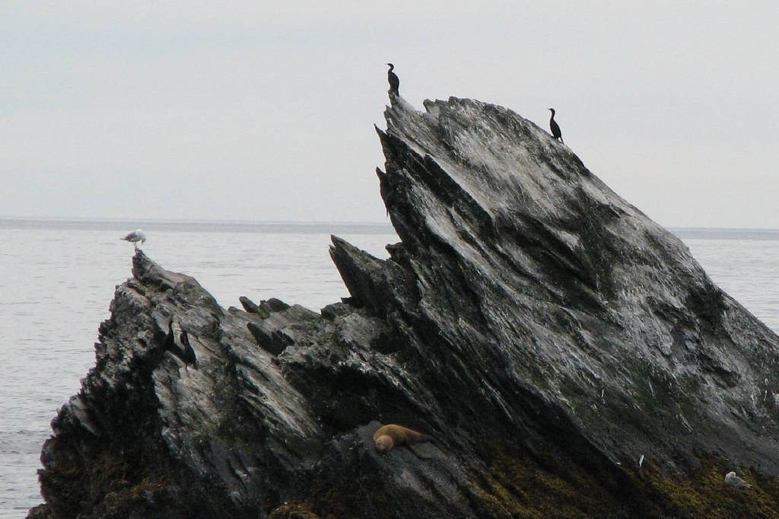
jagged
Vocabulary
Word Association
spiky
pointed
ragged
With rough, sharp points sticking out.
The bird sat on top of the most jagged rock.

Slide 6
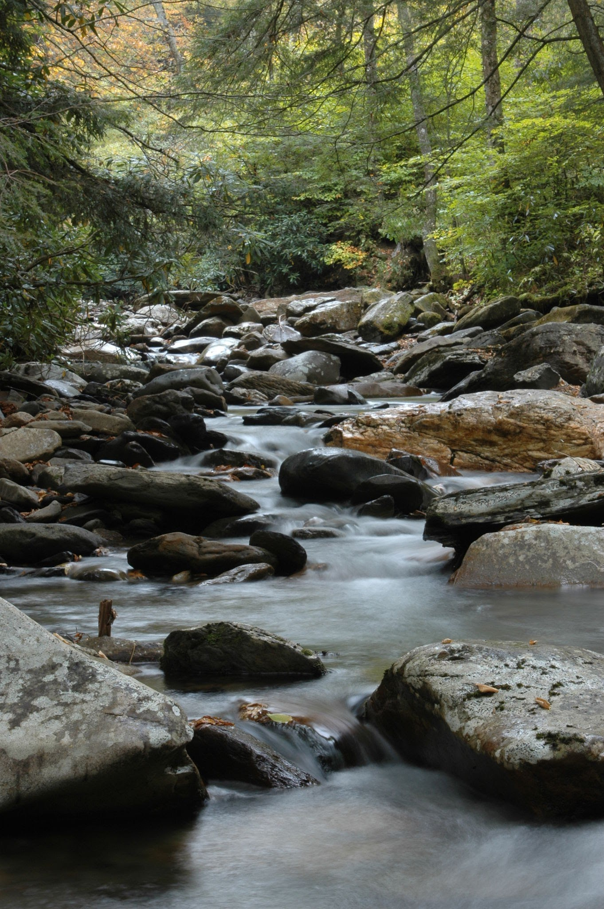
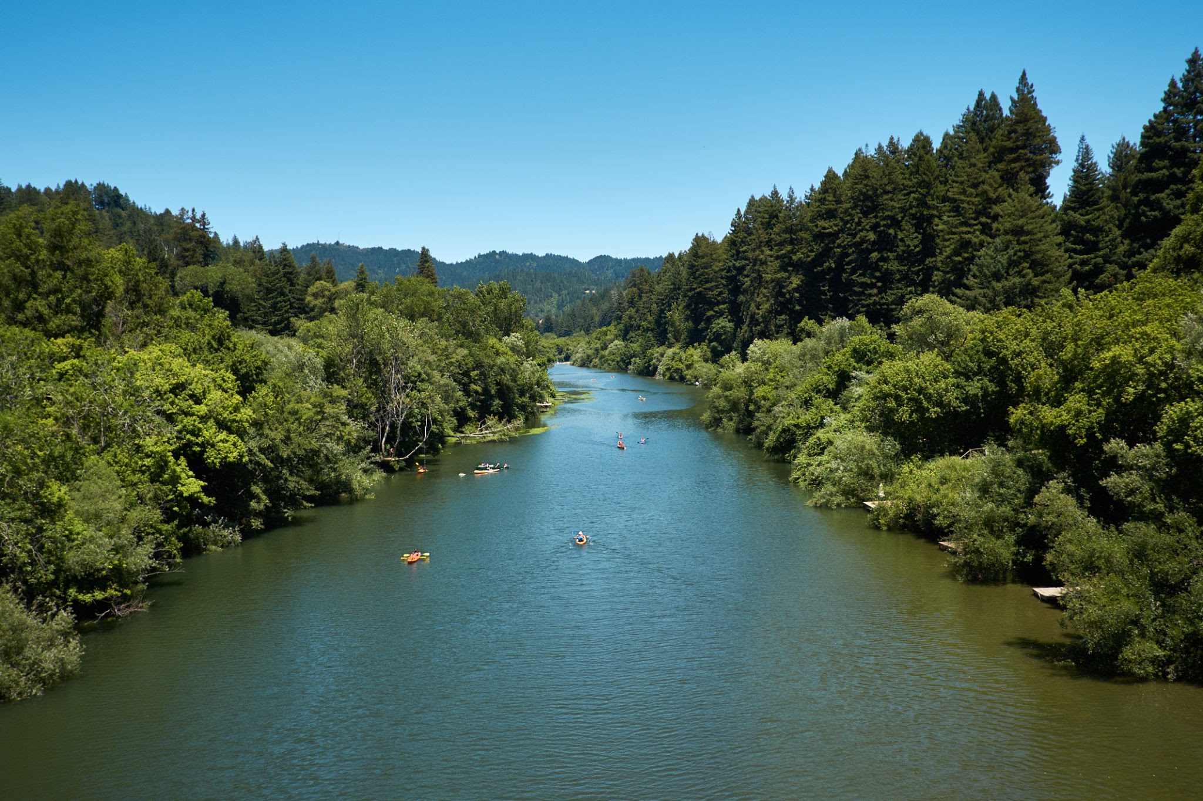
stream
river
A small, narrow flow of water
A large natural stream of water flowing in a channel to the sea, a lake, or another river.

Slide 7
The Little Raindrop
Let’s read the book!
https://www.youtube.com/watch?v=K4UxpqkNYKI
Put your hands on your head when you hear:
gust
dazzling
jagged
stream or river

Slide 8
Learning Intention:
I will listen for a particular purpose.​
​
Success criteria:
I can answer questions about the story to show my understanding. ​
​

Slide 9
Discussion questions
Question 1
What is the setting of the story?
Question 2
Where does the raindrop start his journey?

Slide 10
Discussion questions
Question 3
Question 4
Who was the main character?
What was the ‘dazzling’ place the little raindrop landed when he left the cloud?

Slide 11
Discussion questions
Question 5
Question 6
What moved the little raindrop from the rainbow?
What caused the puddle to overflow?

Slide 12
Discussion questions
Question 7
Question 8:
What did the children race in the water?
What animals did the little raindrop see on his journey?

Slide 13
Discussion questions
Question 9
Question 10
Do you like this book?
Why or why not?
Did this story have a problem?

Slide 14
Discussion questions
Question 11
What did the author mean when she said, “the little raindrop had to carefully avoid the jagged rocks at the bottom of the falls?”
Question 12
What drew the little raindrop back up to the clouds at the end of the story?

Slide 15
The Little Raindrop
Year 2
Tuesday

Slide 16
Today you are going to read the story ‘The Little Raindrop’ again.
Before you watch the read aloud story, talk to an adult about the next few slides and the vocabulary words from the story.
See if you can remember what they mean.

Slide 17
gust
Vocabulary
Word Family
gusty
A sudden strong rush of wind.
The umbrella blew inside out in the sudden gust of wind.

Slide 18
dazzling
Vocabulary
Word Family
dazzled
dazzle
Very bright and beautiful.
I saw the most dazzling rainbow on my walk today.

Slide 19
jagged
Vocabulary
Word Association
spiky
pointed
ragged
With rough, sharp points sticking out.
The bird sat on top of the most jagged rock.

Slide 20
stream
river
A small, narrow flow of water
A large natural stream of water flowing in a channel to the sea, a lake, or another river.

Slide 21
Learning Intention:
I will understand the structure of the text.​
​
Success criteria:
I can identify and describe the beginning, middle and end of this story.​
​

Slide 22
The Little Raindrop
Let’s read the book!
https://www.youtube.com/watch?v=K4UxpqkNYKI
Put your hands on your head when you hear:
gust
dazzling
jagged
stream or river

Slide 23
STRUCTURE
WE DO
Oral
Retell the story to an adult from the beginning to the end.
Remember to list all the places the little raindrop went and tell it in order!

Slide 24
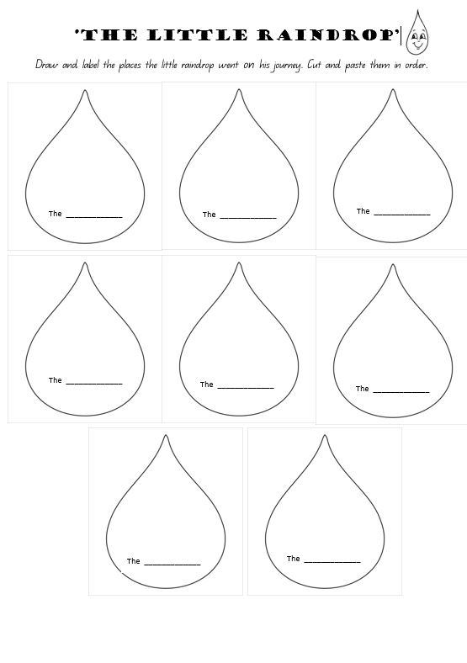
YOU DO
written
SEQUENCING
Draw and label the journey the little raindrop went on from when he left the clouds until when he returned there.
Cut and paste them in order and add decorative details.

Slide 25
The Little Raindrop
Year 2
Wednesday

Slide 26
Today you are going to read the story ‘The Little Raindrop’ again.
Before you watch the read aloud story, talk to an adult about the next few slides and the vocabulary words from the story.
See if you can remember what they mean and where (and if) they are found in the story.

Slide 27
gust
Vocabulary
Word Family
gusty
A sudden strong rush of wind.
The umbrella blew inside out in the sudden gust of wind.

Slide 28
dazzling
Vocabulary
Word Family
dazzled
dazzle
Very bright and beautiful.
I saw the most dazzling rainbow on my walk today.

Slide 29
jagged
Vocabulary
Word Association
spiky
pointed
ragged
With rough, sharp points sticking out.
The bird sat on top of the most jagged rock.

Slide 30
stream
river
A small, narrow flow of water
A large natural stream of water flowing in a channel to the sea, a lake, or another river.

Slide 31
The Little Raindrop
Let’s read the book!
https://www.youtube.com/watch?v=K4UxpqkNYKI
Put your hands on your head when you hear:
gust
dazzling
jagged
stream or river

Slide 32
Learning Intention: I will understand that simple connections can be made between ideas by using a compound sentence with two or more clauses usually linked by a coordinating conjunction.
Success Criteria:
I can make a compound sentence with two or more clauses linked by a coordinating conjunction.

Slide 33
GRAMMAR Which adjective goes with each sentence in the story to make them more interesting?
We do
swirling
A ______________flash of red, orange and yellow, he found himself inside a rainbow.
shimmering
He played with small, _____________ fish.
dazzling
Dodging the _______________ grass and ______________ leaves.
fluttering

Slide 34
GRAMMAR Add in an adjective or two, in the following sentences to make them more interesting.
You do
The fish swam in the stream.
The rain fell on the ground.
The rainbow was bright.
The dolphins jumped in the sea.
The children played.

Slide 35
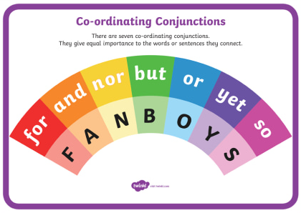
GRAMMAR ‘FANBOY’
WE do
Click on the link in the picture to learn about what ‘the acronym FANBOY’ stands for.

Slide 36
GRAMMAR Now see if you add another phrase to each sentence by using the words AND, BUT, SO or BECAUSE.
You do
The raindrop fell from the cloud AND landed softly in a small puddle.
The fish swam in the stream.
The rain fell on the ground.
The rainbow was bright.
The dolphins jumped in the sea.
The children played.

Slide 37
The Little Raindrop
Year 2
Thursday

Slide 38
gust
Vocabulary
Word Family
gusty
A sudden strong rush of wind.
The umbrella blew inside out in the sudden gust of wind.

Slide 39
dazzling
Vocabulary
Word Family
dazzled
dazzle
Very bright and beautiful.
I saw the most dazzling rainbow on my walk today.

Slide 40
jagged
Vocabulary
Word Association
spiky
pointed
ragged
With rough, sharp points sticking out.
The bird sat on top of the most jagged rock.

Slide 41
stream
river
A small, narrow flow of water
A large natural stream of water flowing in a channel to the sea, a lake, or another river.

Slide 42
Learning Intention:
I will understand the structure of the text.​
​
Success criteria:
I can create a short text using my growing knowledge of the structure of imaginative texts.

Slide 43
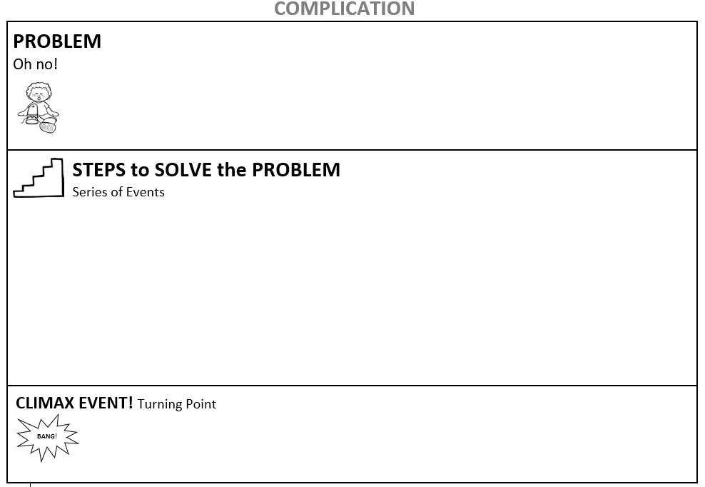
IMAGINATIVE TEXT
Look at the following picture on the next slide and write a story with a problem(complication) in it. This picture can be the start of your story or the climax...
You can use the template to help you.

Slide 44
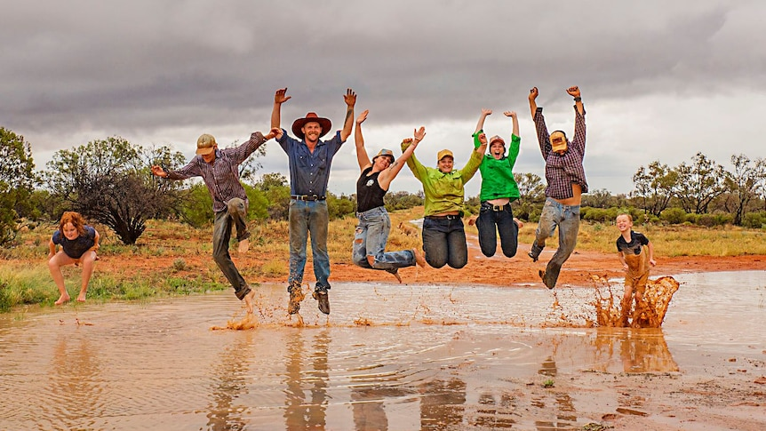

Slide 45
The Little Raindrop
Year 2
Friday

Slide 46
Today you are going to read the story ‘The Little Raindrop’
for the last time.
Before you watch the read aloud story, talk to an adult about the next few slides and the vocabulary words from the story.
See if you can remember what they mean and how (if) they are used in the story.

Slide 47
gust
Vocabulary
Word Family
gusty
A sudden strong rush of wind.
The umbrella blew inside out in the sudden gust of wind.

Slide 48
dazzling
Vocabulary
Word Family
dazzled
dazzle
Very bright and beautiful.
I saw the most dazzling rainbow on my walk today.

Slide 49
jagged
Vocabulary
Word Association
spiky
pointed
ragged
With rough, sharp points sticking out.
The bird sat on top of the most jagged rock.

Slide 50
stream
river
A small, narrow flow of water
A large natural stream of water flowing in a channel to the sea, a lake, or another river.

Slide 51
The Little Raindrop
Let’s read the book!
https://www.youtube.com/watch?v=K4UxpqkNYKI
Put your hands on your head when you hear:
gust
dazzling
jagged
stream or river

Slide 52
Learning Intention: I will use punctuation accurately and write words and sentences legibly using unjoined upper and lower-case letters.
Success Criteria:
I can write words and sentences legibly using this week’s vocabulary words and with correct punctuation.

Slide 53
Use this week’s vocabulary words in interesting sentences to show you understand their meaning.
*Upload your sentence page/activity to the Padlet.
gust
dazzling
jagged
stream
river

